Slide 1
Dot convention
Dot convention is used to establish the choice of correction for the induced voltage in coupled circuits.
Circular dot marks and/or special symbols are placed at one end of each of two coils which are mutually coupled to simply the diagrammatic presentation of the winding and its core

Slide 2
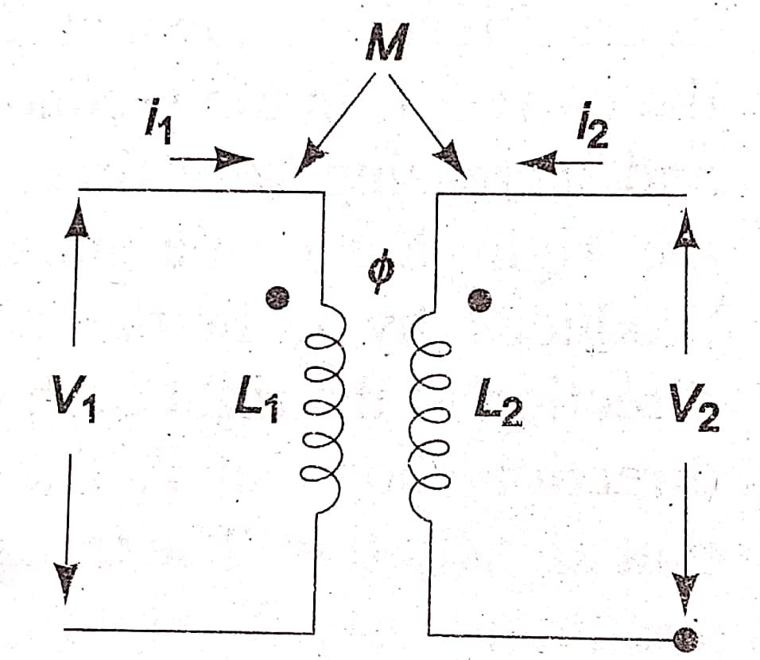
Let us consider fig
Which shows a pair of linear, time invariant, coupled inductors with self inductances L₁ and L₂ and mutual inductance M
If these inductors from a portion of a network, currents i₁ and i₂ are shown each arbitrarily assumed entering at the dotted terminals, and
Voltages v₁ and v₂ are developed across the inductors.

Slide 3
The voltage across L₁ is, thus composed of two parts and is given by
The first term on the RHS of the above equation is the self induced voltage due to i₁ and second term represents the mutual induced voltage due to i₂

Slide 4
Similarly
Although the self induced voltages are designed with positive sign, mutually induced voltages can be either positive or negative depending on the direction of the winding of the coil and can be decided by the presence of the dot placed at one end of each of the two coils

Slide 5
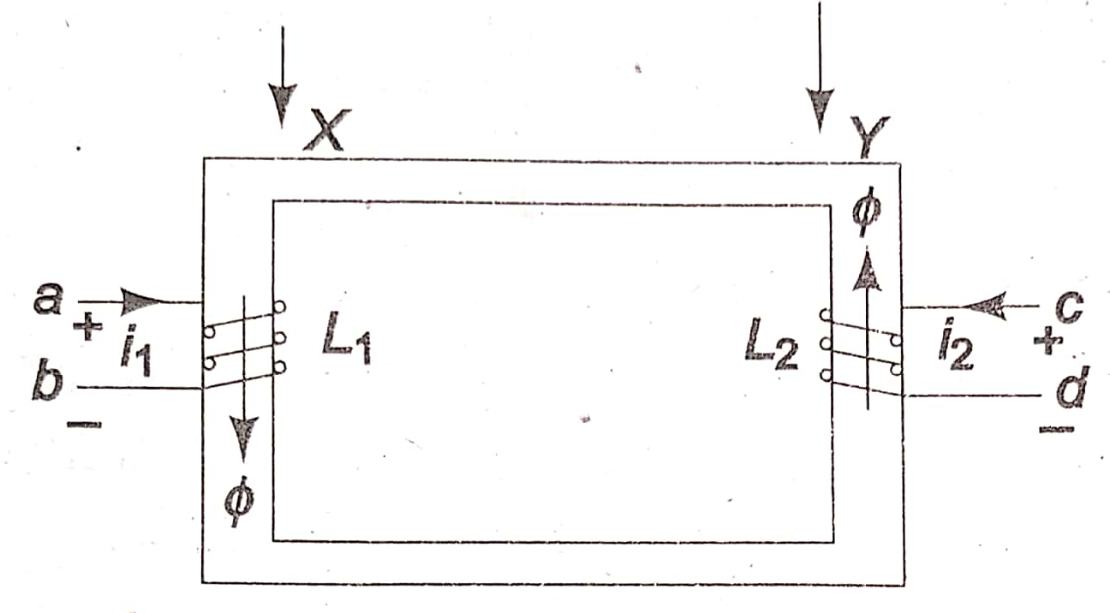
The physical basis of the dot convention can be benefited by examining Fig. Two coils ab and cd are wound on a common iron core.
The direction of the winding of the coil ab is clock-wise around the core as viewed at X, and that of cd is anti clockwise as viewed at Y.
Let the direction of current i₁, in the first coil be from a to b, and increasing with time.
The flux produced by i₁, in the core has direction which may be found by right hand rule, and which is downwards in the left limb of the core.
The flux also increases with time in the direction shown at X

Slide 6
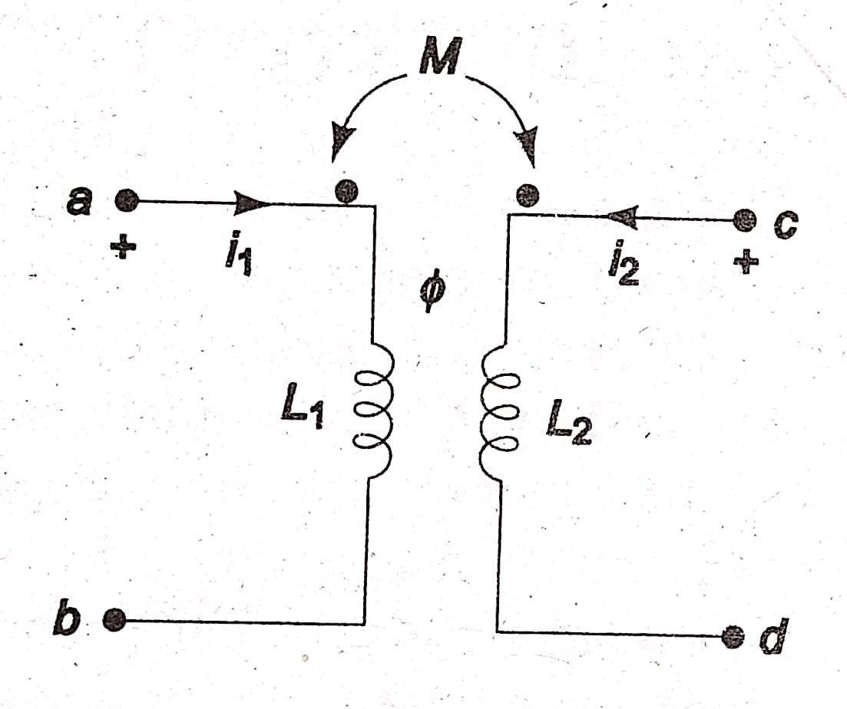
Now suppose that the current is in the second coil is from c to d, and increasing with time,
The application of the right hand rule indicates that the flux produced by Fig. in the right limb of the core.
The flux also increases with time in the direction shown at Y.
The assumed currents i₁ and i₂ produce flux in the core that are additive.
The terminals a and c of the two coils attain similar polarities simultaneously.
The two simultaneously positive terminals are identified by two dots by the side of the terminals

Slide 7
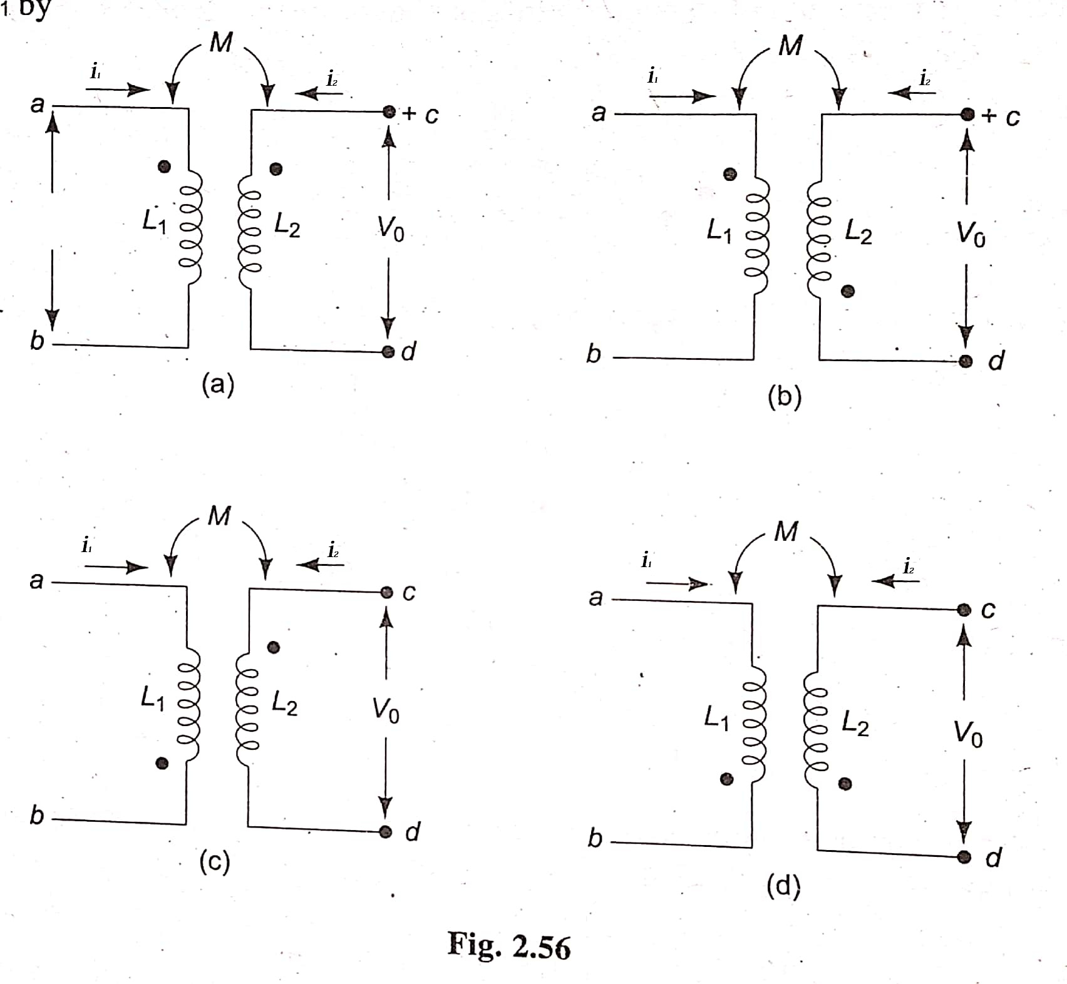
Write the equations for voltage vo for the circuits shown in fig

Slide 8
solution

